Slide 1
Loan Performance Prediction
MA 5790 - Group #13
Rahul Teja Bolloju
Haranadh Reddy Ravi

Slide 2
Index
Problem Statement
Goal
Data Pre-processing
Explore data
Data pre-processing
Splitting the data
Model building
Comparison
Summary

Slide 3
Problem Statement
Financial institutions face significant challenges in accurately identifying individuals at high risk of defaulting on their loans. Loan defaults can result in substantial financial losses and impact responsible lending practices.

Slide 4
Goal of the Study
The goal of the study is to develop a machine learning model for predicting loan defaults. Here are the key objectives of the study:
Default Prediction: The primary goal is to build a predictive model that can accurately identify individuals who are likely to default on their loans. This is important for financial institutions to minimize financial losses and ensure responsible lending practices.
Risk Assessment: The study aims to assess and quantify the risk associated with each loan applicant or borrower. By doing so, it helps financial institutions make informed decisions about whether to approve or deny loan applications and what terms to offer.

Slide 5
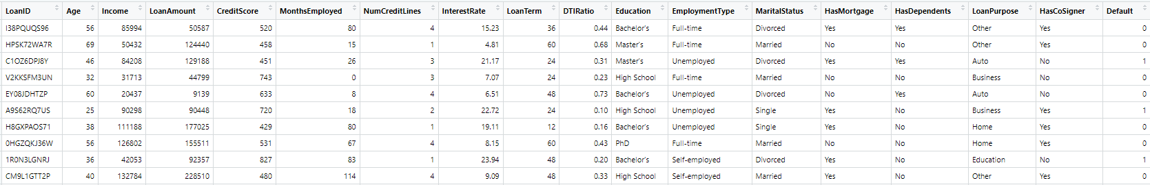
Data Structure
Data source - Kaggle
Data structure
4,337 instances
18 variables
17 predictor variables
1 target variable

Slide 6
Data Analysis
Numerical Variable - 10
Categorical Variables - 7

Slide 7
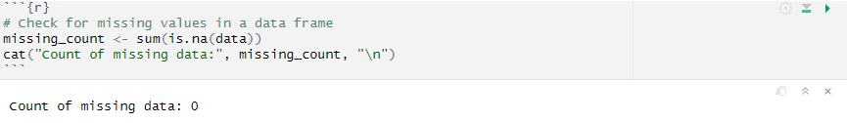
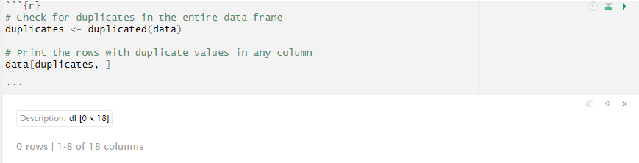
Data Analysis
Checked for missing values
Checked if there are any Duplicates in the data

Slide 8
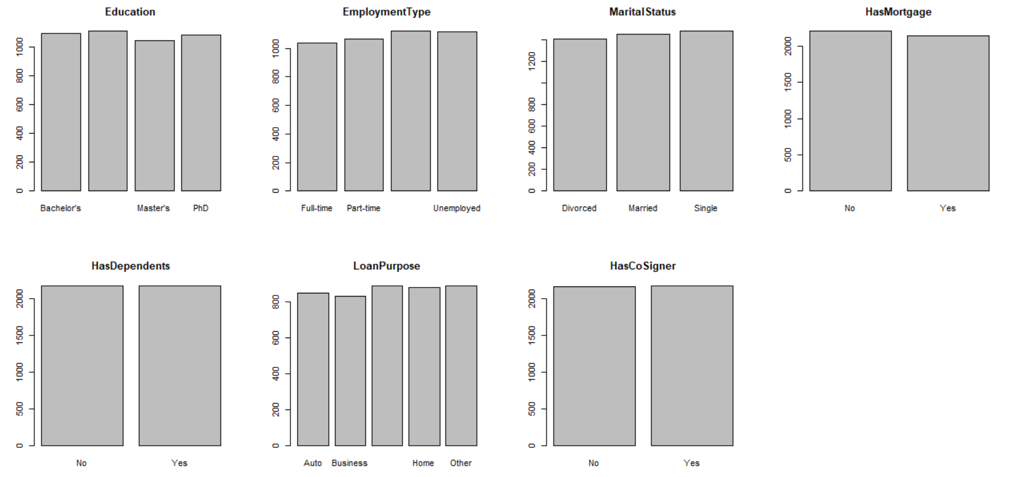
Analysis of Categorical Variables

Slide 9
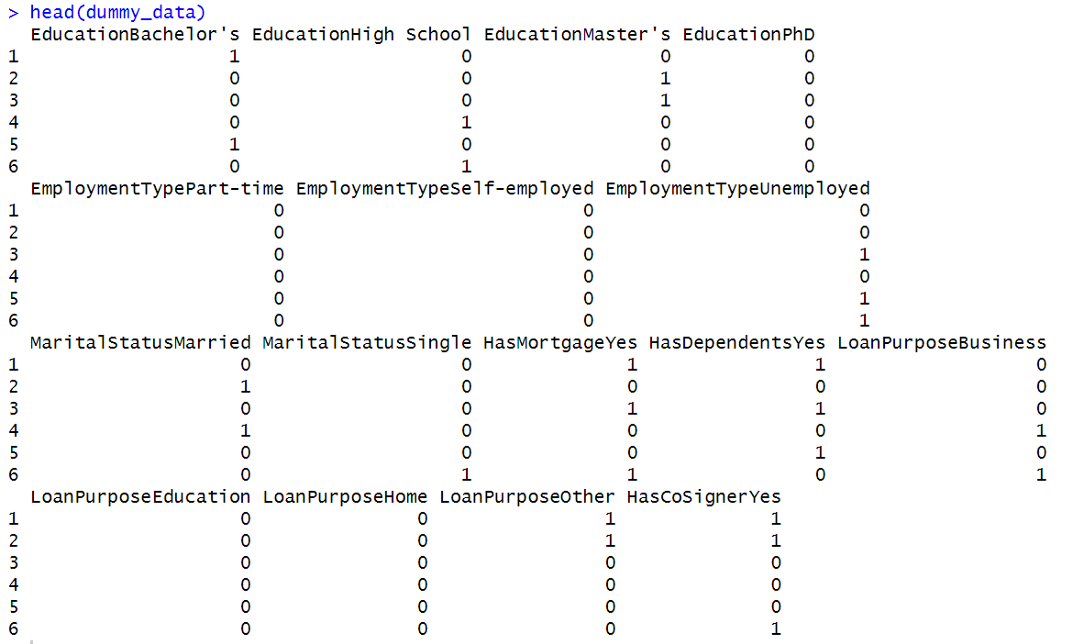
Data Preprocessing
one-hot encoding
Represents Categorical data as binary vectors.
After one-hot encoding there are 16 categorical features.

Slide 10
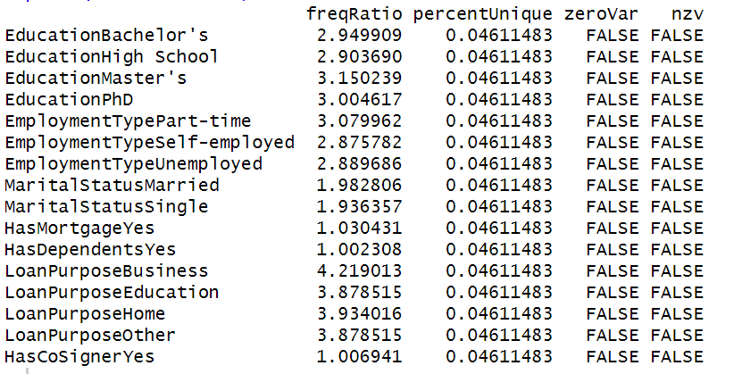
Near Zero Variance
From this it is evident that there are no near zero variance variables.

Slide 11
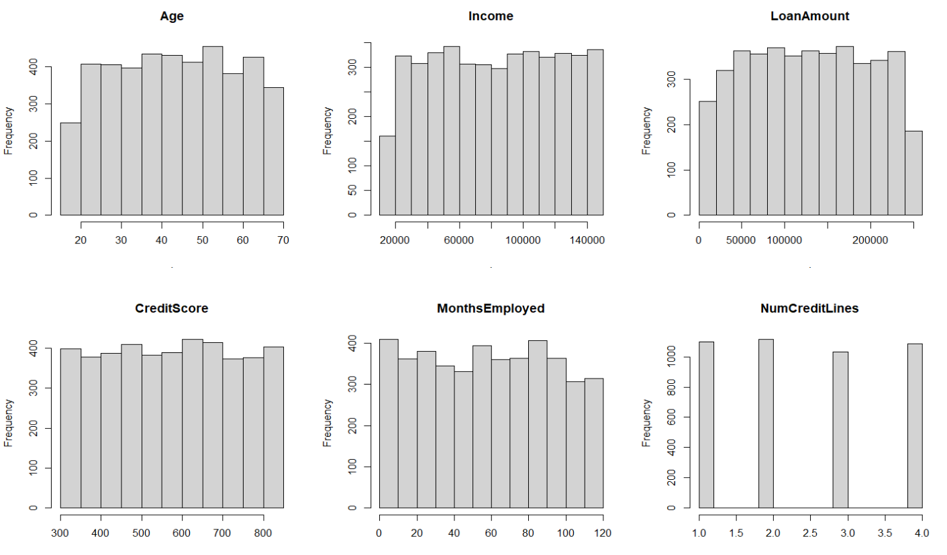
Analysis of Numerical Variables

Slide 12
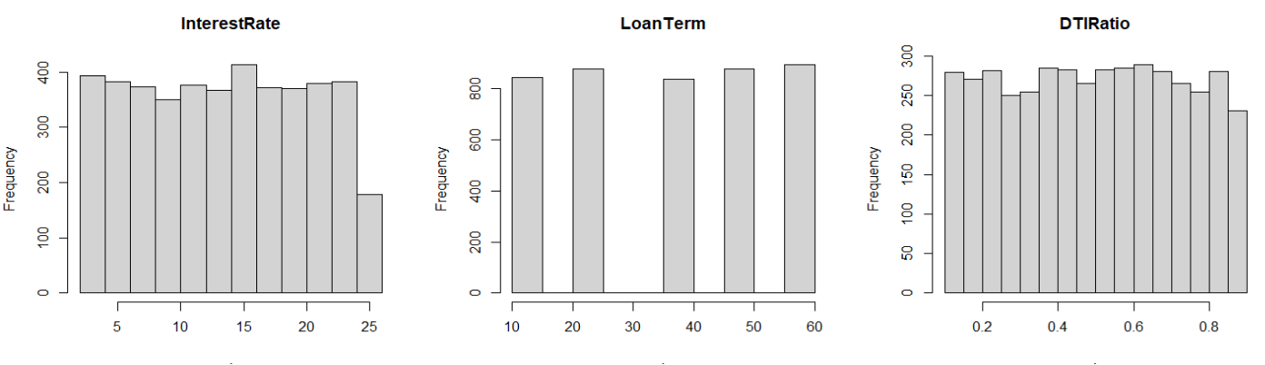
From the histograms we can say that all the plots are uniformly distributed. There is no need of Transformations,since there is no Skewness.

Slide 13
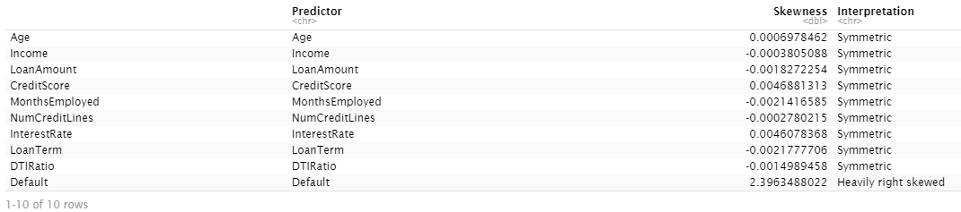
Observing the Skewed predictors (sapply)

Slide 14
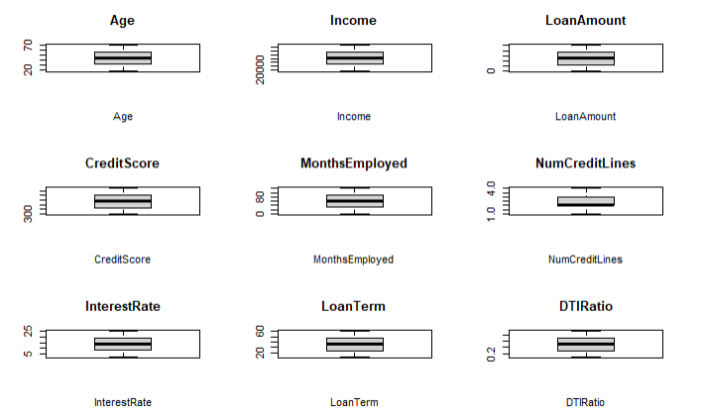
Checking Outliers with box plots
From this box plots we can say that there are no Outliers

Slide 15
Symmetry: The data appears to exhibit symmetry, as indicated by a balanced distribution of values on either side of the central peak in the histogram and a symmetric shape in the density plot.
Uniform Distribution: The data seems to follow a uniform distribution, with values being equally likely to occur within the range. This is evident from the histogram showing roughly equal frequencies for different value intervals and a flat or uniform shape in the density plot

Slide 16
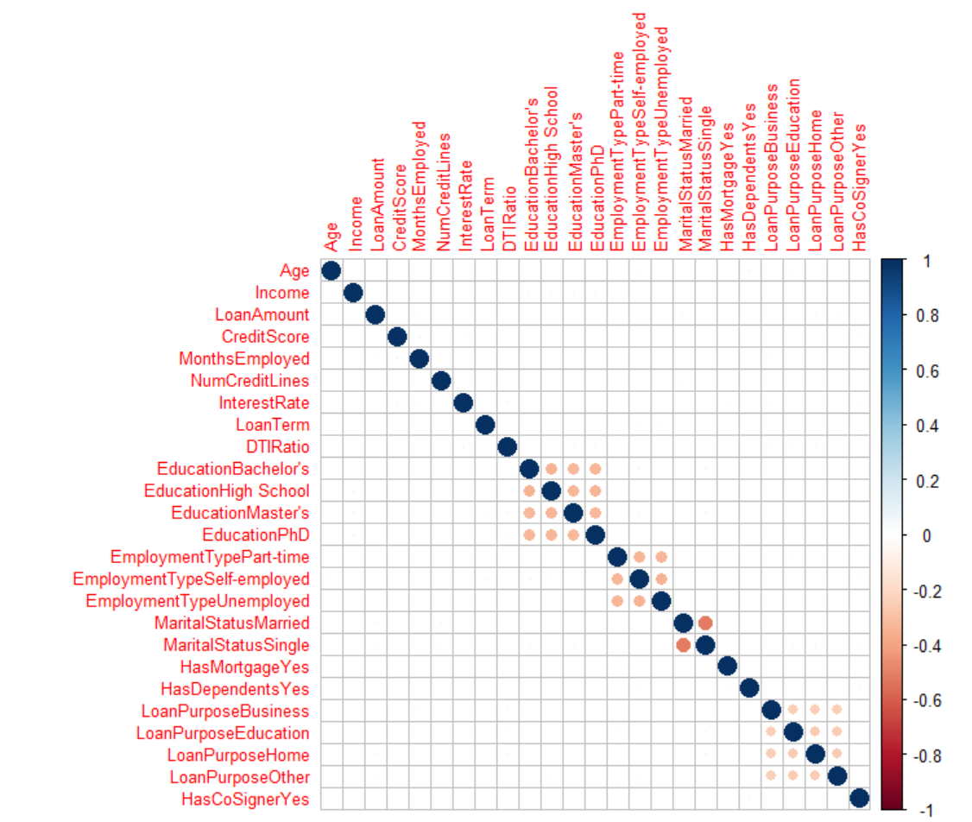
Correlation Matrix
There is no correlation between the predictors
So all the numerical variable are useful to predict the target variable

Slide 17
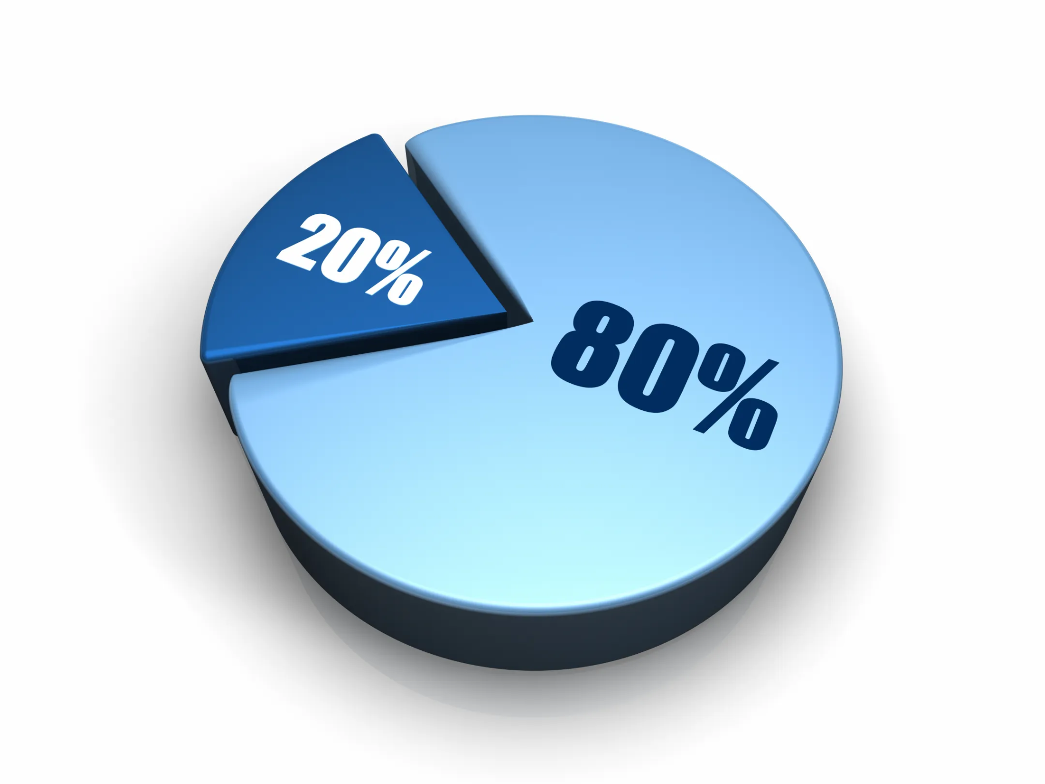
Splitting the data
Divided 4,347 instances into training and testing datasets.
Implemented cross validation resampling with 5 folds.
Managing Large Data with 254,347 instances, processing the entire dataset is time-consuming and exceeds system capabilities.
Extracted a manageable subset of 4,347 instances for faster processing.
Test Data
Train data

Slide 18
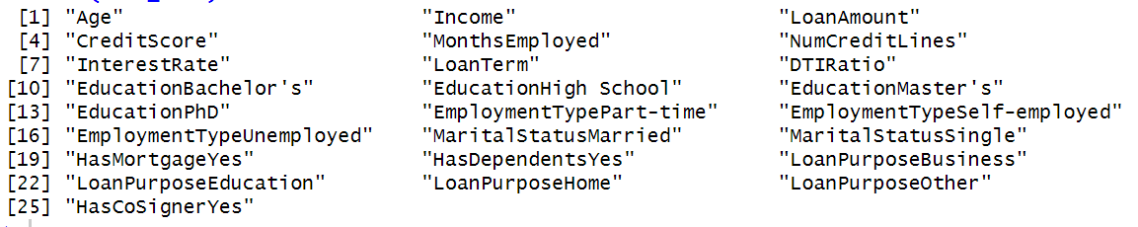
After Preprocessing
Sample Size: 4,337
Training data: 3470
Testing data: 867
Number of predictors: 25
1 Response Variable

Slide 19
Classification Models
Linear Models | Non Linear Models
Logistic Regression | Multivariate Adaptive Regression Splines(MARS)
Linear Discriminant Analysis(LDA) | Support Vector Machine(SVM)
Partial Least Square Discriminant Analysis(PLSDA) | K Nearest Neighbours(KNN)
Penalized | Neural Networks
Nearest Shrunken Centroids | Flexible Discriminant Analysis

Slide 20
Linear Classification Models

Slide 21
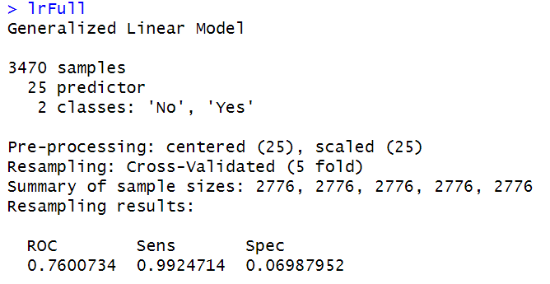
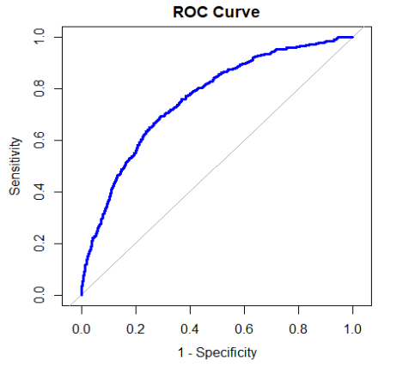
Logistic Regression
Area Under the Curve: 0.7600734

Slide 22
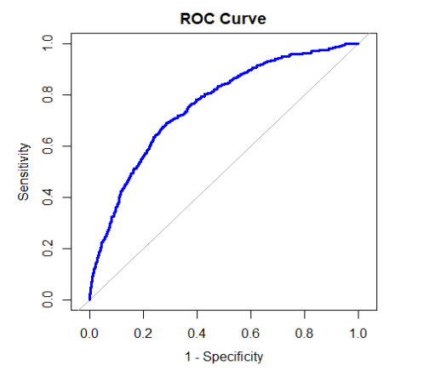
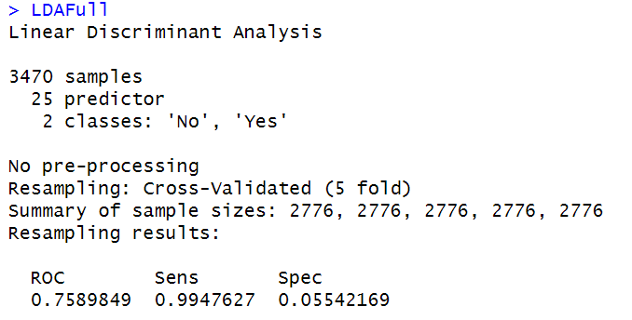
LDA
Summary
Area Under the Curve: 0.7589849

Slide 23
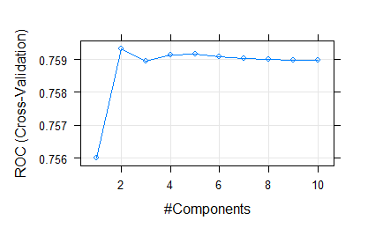
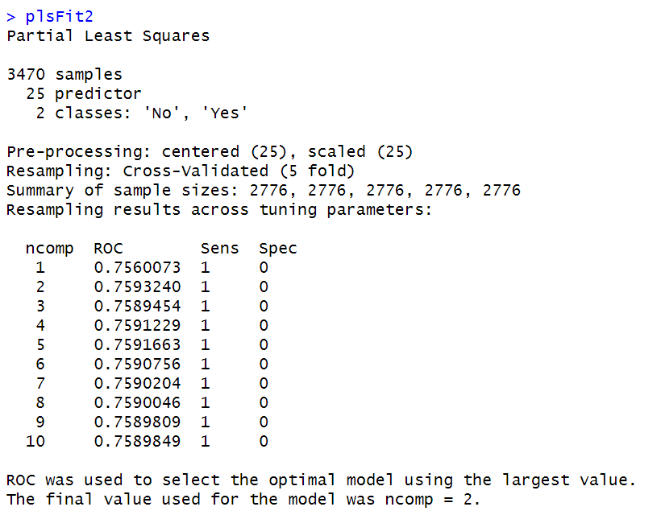
PLSDA
Summary
Area Under the Curve: 0.7593240

Slide 24
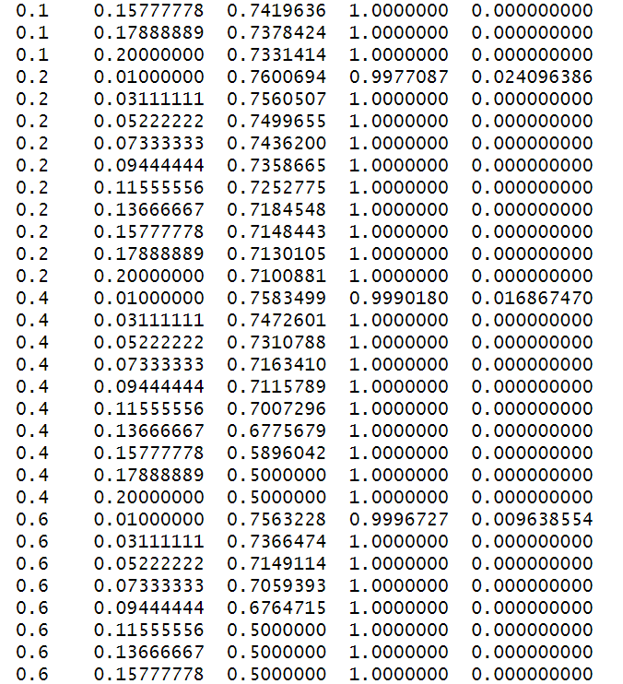
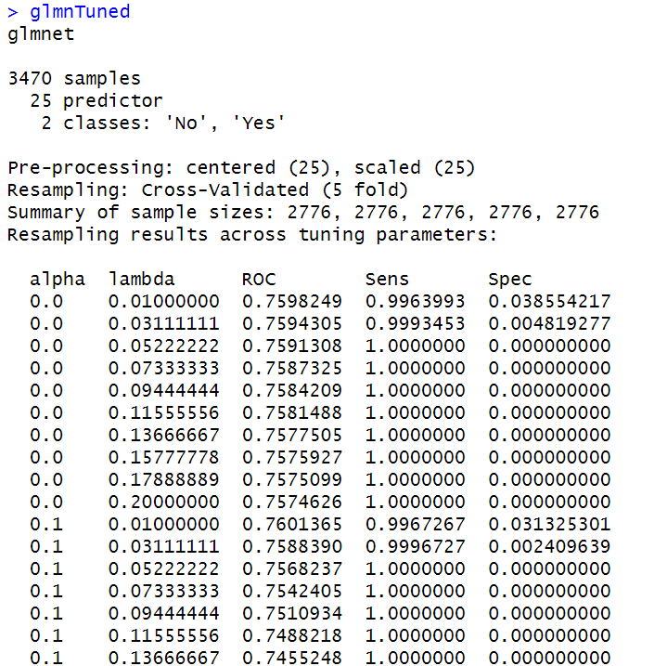
Penalized
Summary

Slide 25
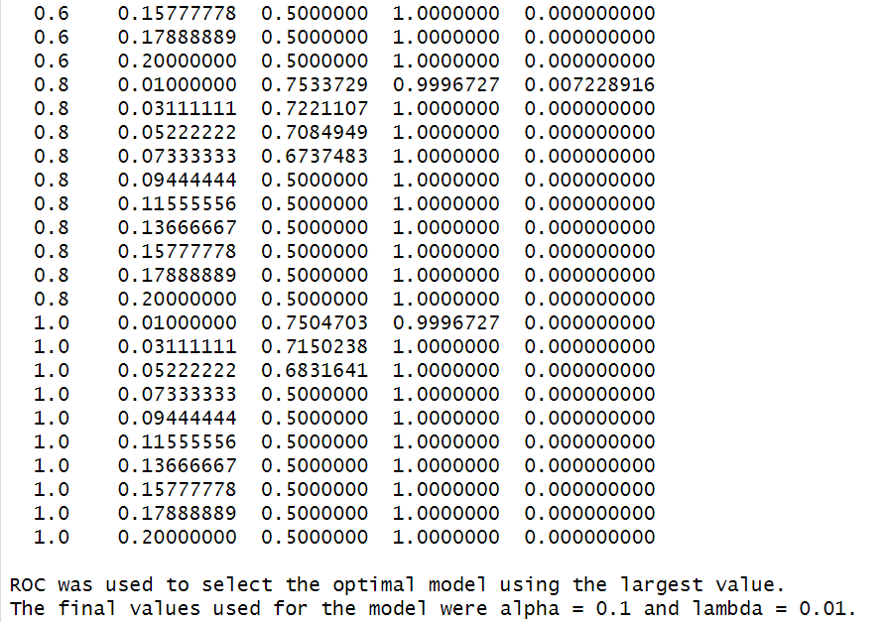
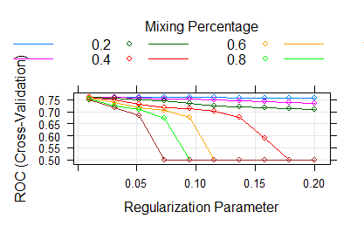
Area Under the Curve: 0.7601365

Slide 26
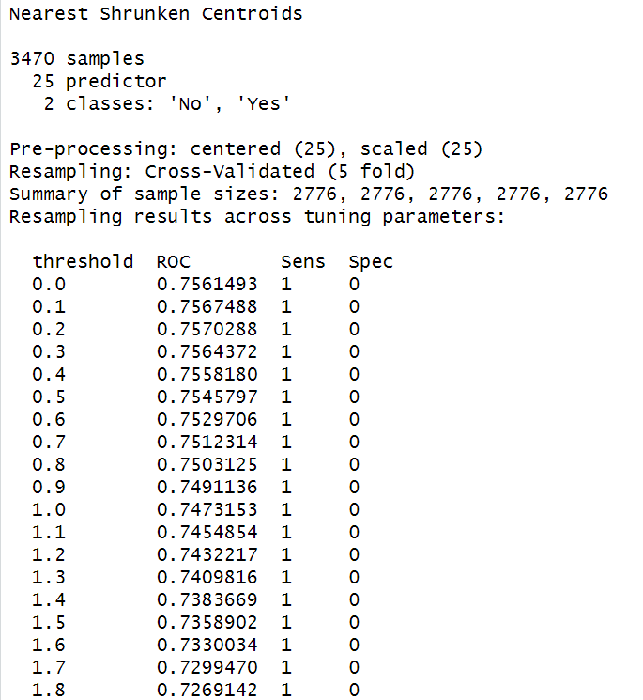
Nearest Shrunken Centroids

Slide 27
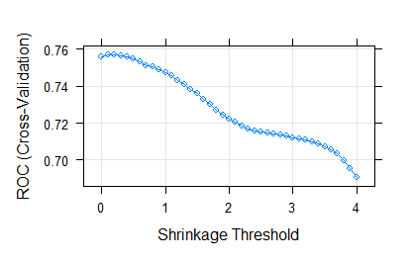
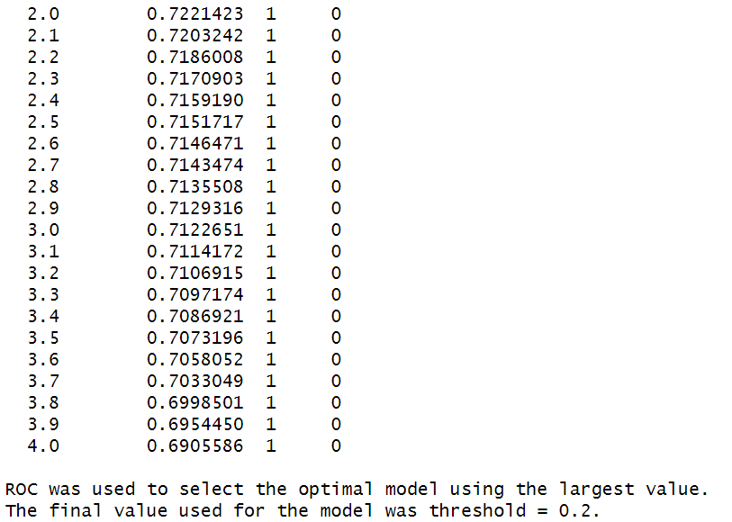
Area Under the Curve: 0.7570288

Slide 28
NON LINEAR CLASSIFICATION MODELS

Slide 29
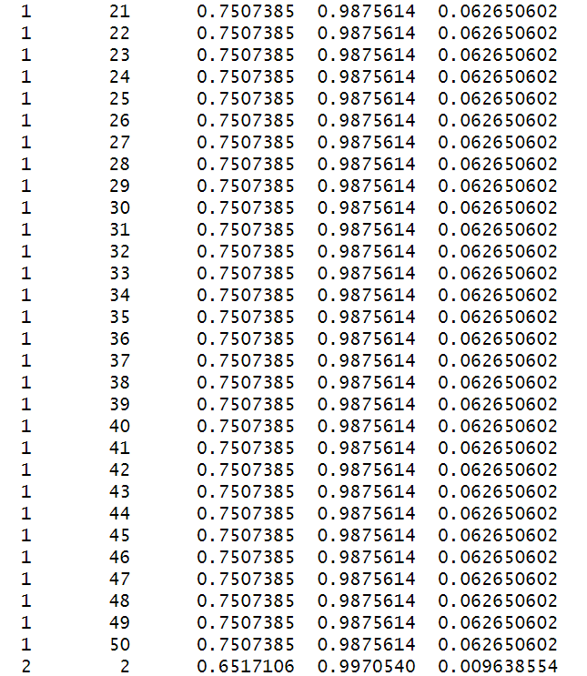
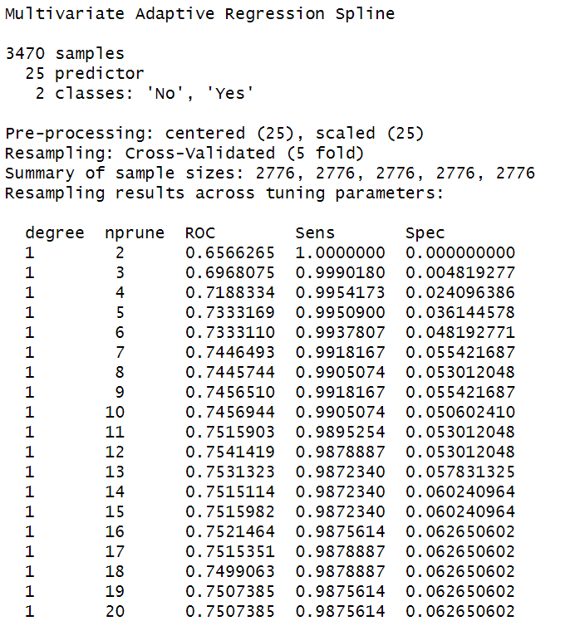
MARS

Slide 30
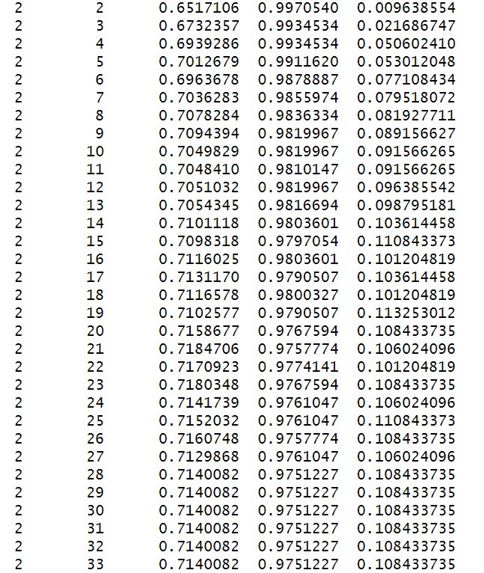
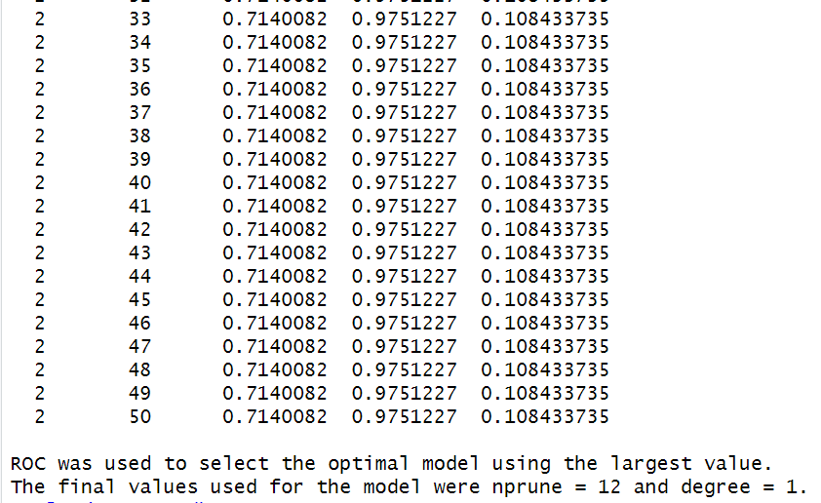
Area Under the Curve: 0.7541419

Slide 31
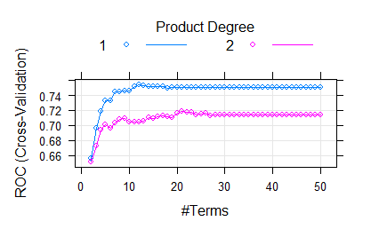
Tuning Parameter Plot of MARS Model

Slide 32
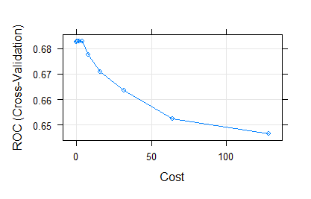
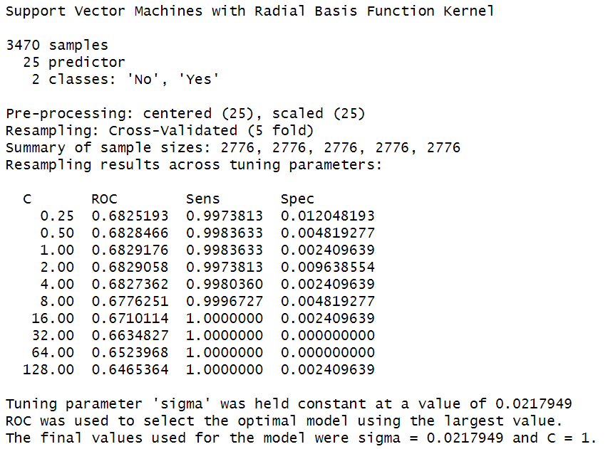
SVM
Area Under the Curve: 0.6829176

Slide 33
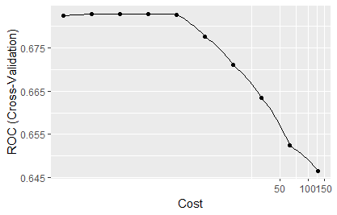
Tuning Parameter Plot of SVM Model

Slide 34
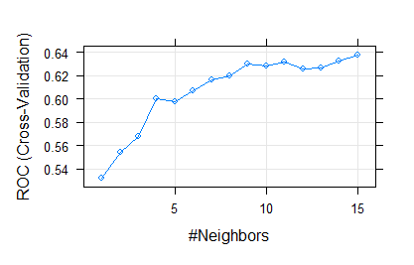
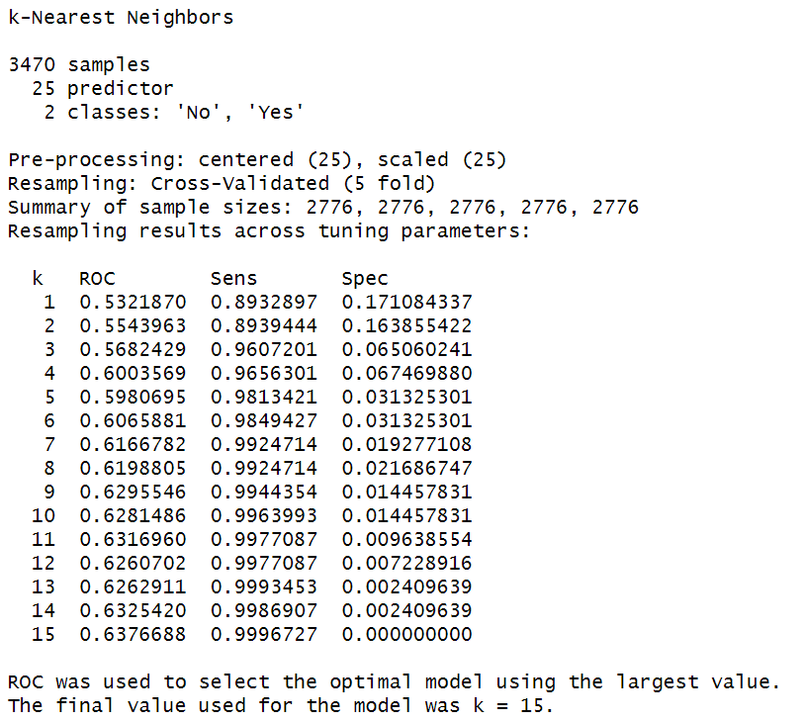
KNN
Area Under the Curve: 0.6376688

Slide 35
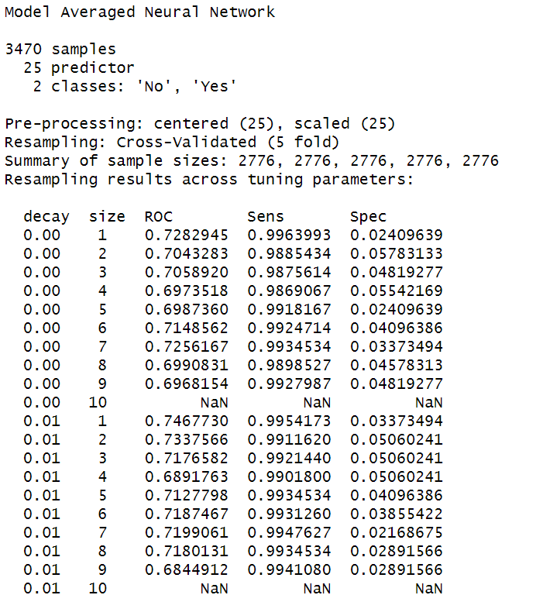
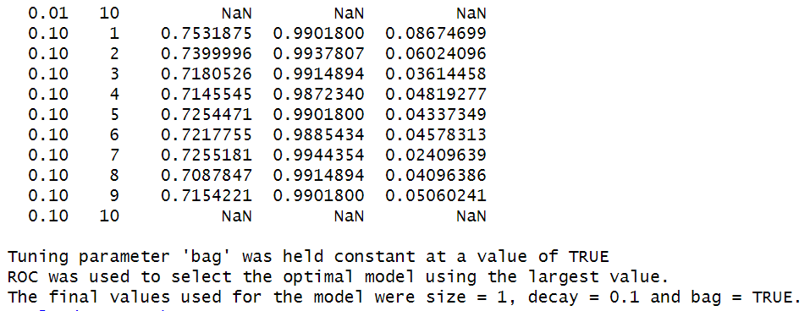
Neural Networks
Area Under the Curve: 0.7531875

Slide 36
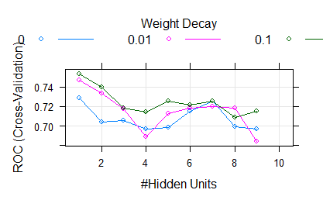
Tuning Parameter Plot of Neural Networks Model

Slide 37
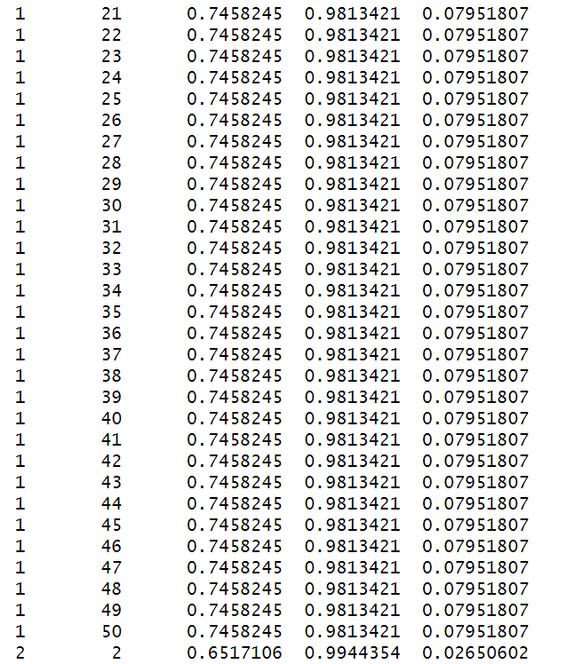
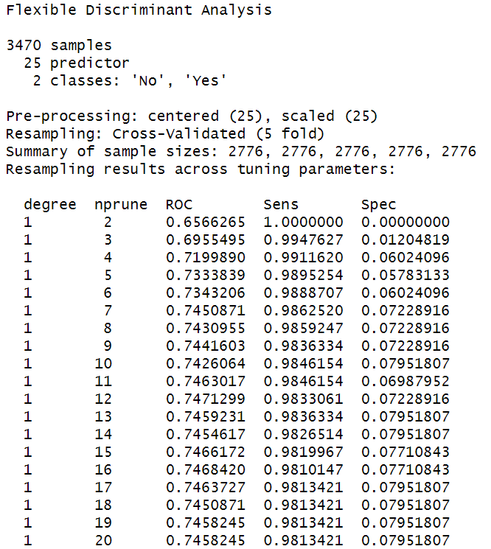
Flexible Discriminant Analysis

Slide 38
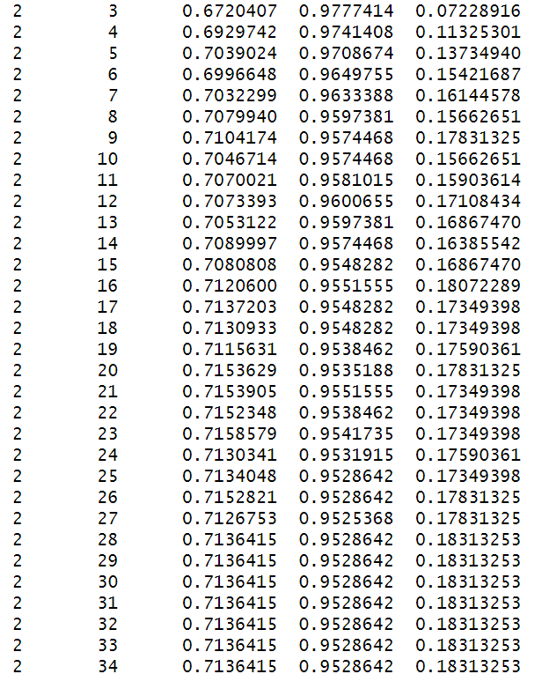
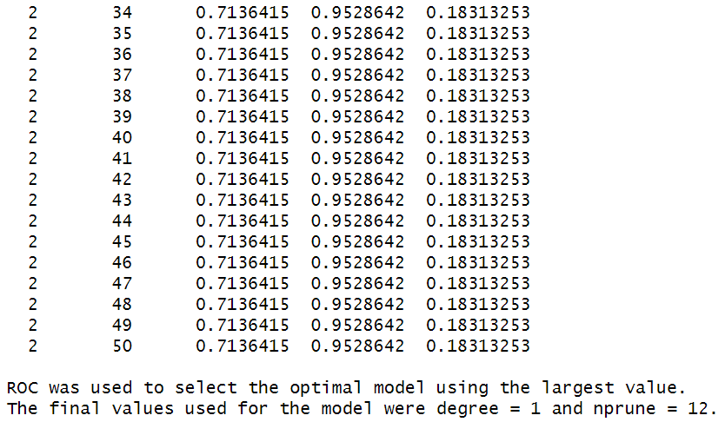
Area Under the Curve: - 0.7471299

Slide 39
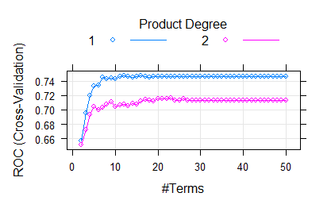
Tuning Parameter Plot of Neural Networks Model

Slide 40
Summary Table
MODEL | ROC | SENSITIVITY | SPECIFICITY | BEST TUNING PARAMETERS
Logistic Regression | 0.7600734 | 0.9924714 | 0.06987952 | NA
LDA | 0.7589849 | 0.9947627 | 0.05542169 | NA
PLSDA | 0.7593240 | 1 | 0 | ncomp=2
Penalized | 0.7601365 | 0.9967267 | 0.031325301 | alpha=0.1,lambda=0.01
Nearest Shrunken Centroids | 0.7570288 | 1 | 0 | threshold=0.2
MARS | 0.7541419 | 0.9878887 | 0.053012048 | nprune=12 , degree = 1
SVM | 0.6829176 | 0.9983633 | 0.002409639 | sigma=0.0217949,c=1
KNN | 0.6376688 | 0.9996727 | 0 | k=15
NEURAL NETWORKS | 0.7531875 | 0.9901800 | 0.08674699 | size=1,decay=0.1,bag=true
FDA | 0.7471299 | 0.9833061 | 0.07228916 | Nprune = 12, degree = 1

Slide 41
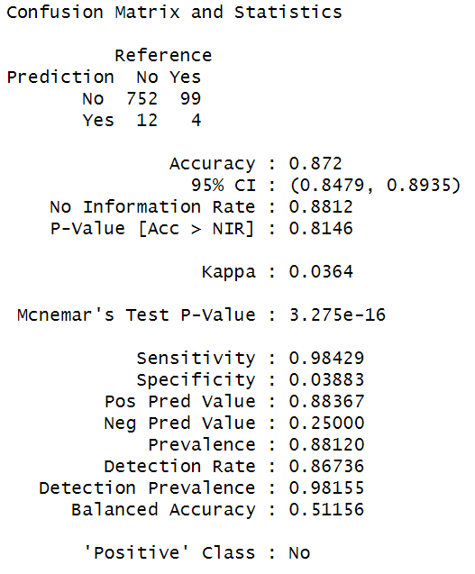
Best Classification Models
1).Logistic Regression

Slide 42
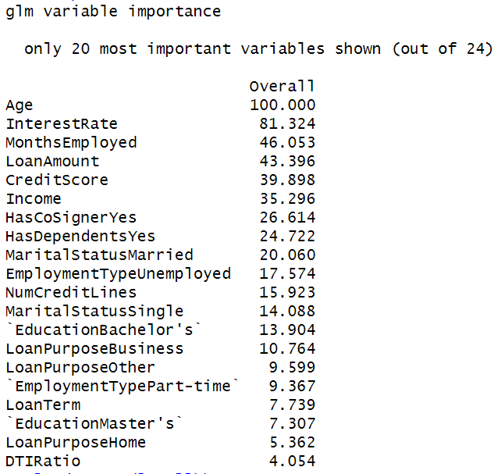
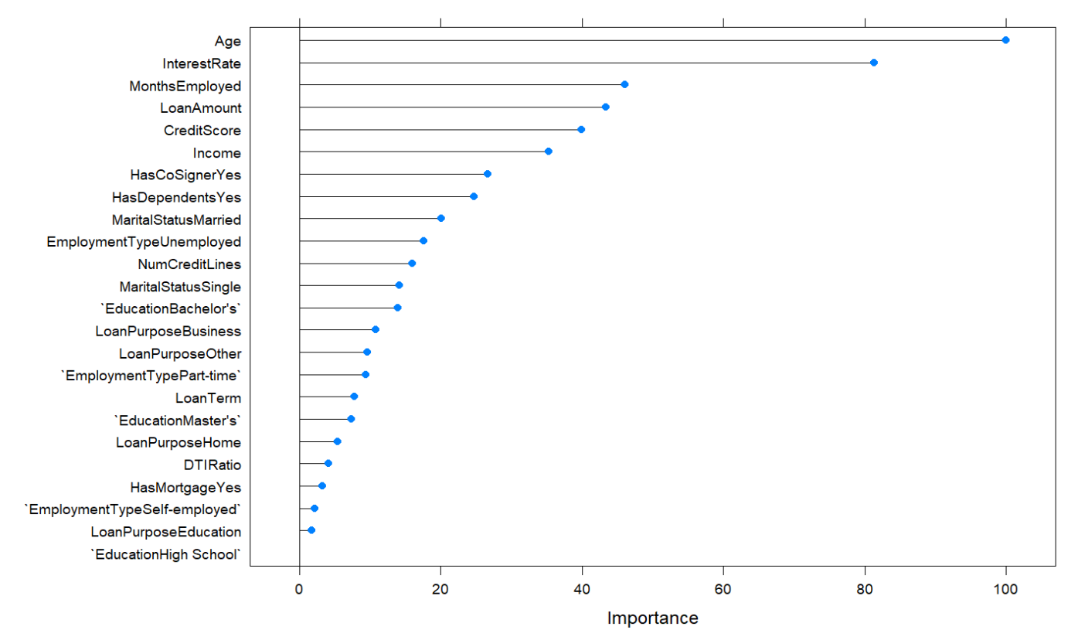
Important Predictors of Logistic Regression

Slide 43
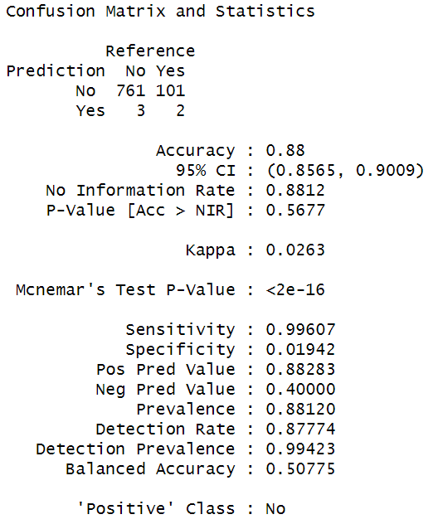
2). Penalized Model

Slide 44
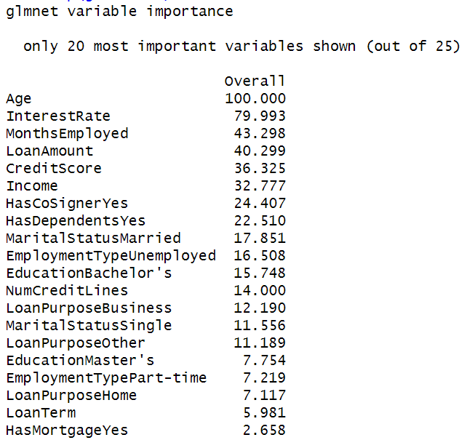
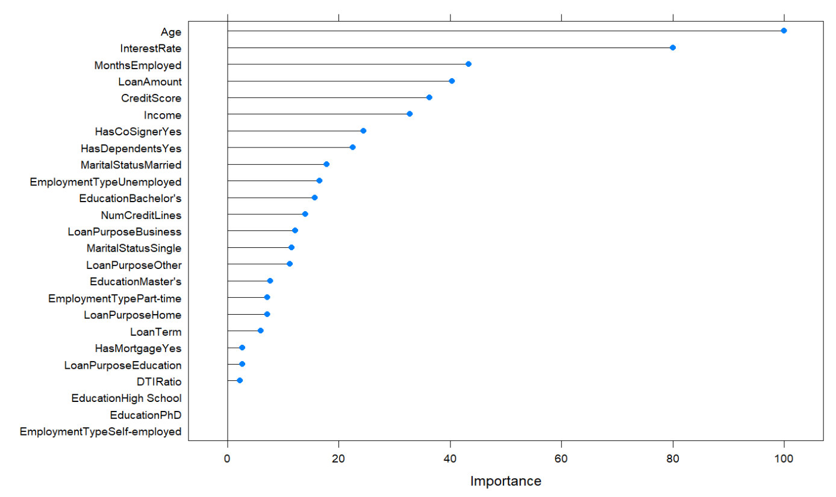
Important Predictors of Penalized

Slide 45
Final Recommendation on Best Model
Best Model is Logistic Regression : -
Area Under the Curve = 0.5116
The optimal model is logistic regression, based on the Receiving Operator Characteristic (ROC)'s Area Under the Curve (AUC).

Slide 46


